Slide 1
Ultimate Test Drive:
ML-Powered Next-Generation Firewall
Will Start our Session
at top of the hour.
Vishal Giri
Notes:
Hello Everyone. Good Morning / Good afternoon wherever you are.
Welcome to the Ultimate Test Drive ML- Powered Next-Generation Firewall. We shall be starting our session at the top of the hour.

Slide 2
Ultimate Test Drive:
ML-Powered Next-Generation Firewall`
Vishal Giri
Notes:
Hello Everyone. Good Morning / Good afternoon wherever you are.
Welcome to the Ultimate Test Drive ML- Powered Next-Generation Firewall. We shall be staring our session at the top of the hour.

Slide 3
Agenda
Introductions
ML-Powered Next-Generation Firewall Overview
Hands-on Workshop
Q&A
Notes:
Let me introduce myself.
My Name is Vishal Giri and I am your instructor for this session..
I am a Palo alto Networks Certified Engineer working for SecureDynamics and we are delivering this UTD on behalf of Palo Alto Networks
Talking about SecureDynamics we are Co-Managed services, Professional services and support partner of Palo Alto Networks and we’ve been working with them on Firewall, Cortex and Prisma Cloud deployments for the past 7 years
Apart from this, There are 8 different topics of UTDs that we deliver worldwide like, SASE, AWS, GCP , etc..
Let me share you a link in our chat window where you will find the schedule of upcoming UTDs. Feel free to check and get enrolled for your interesting topic to learn more about it.

Slide 4
Agenda
Introductions
ML-Powered Next-Generation Firewall Overview
Hand-on Workshop
Q&A
Notes:
So here is the agenda of our session today.
Basically, this session is divided into two parts 1st section is the Presentation which will take around 40 mins. In this, we will discuss current challenges in the industry and what solution Palo alto networks bring to the table.
I will touch base about the Palo Alto network ML Powered Next-generation firewall and give you an overview of it and cover our platform approach.
2nd Section is a Hands-on LAB. You will have around 3 hrs. to work on the LAB.
Let me tell you, this session and your LAB is based on the latest and greatest PAN-OS 10.1, and you are going to get the ML-Powered next-generation firewall in your LAB for hands-on. Well that’s pretty exciting, isn’t it!!
I will share a workshop guide and LAB access details with you by end of my presentation. I will be available for the next 2 hours to assist you.
Also, we have a Q&A at the end of my presentation. Feel free to ask any question or queries you may have during the session and for that kindly use Q&A box of this zoom webinar so I can view and track your questions easily.
I will do my best to answer promptly but if some of your questions may require further research , sure I will do it and get back to you
So without any further delay lets go ahead and get started

Slide 5

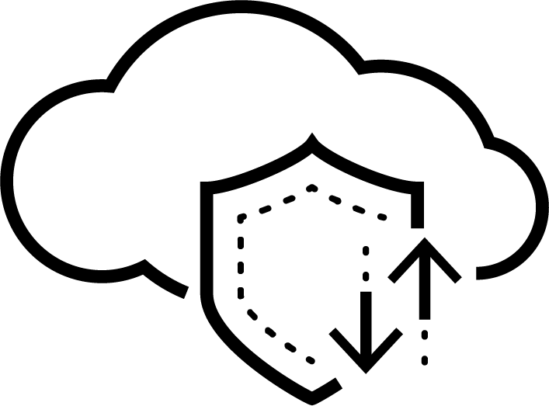


Network Security Challenges Today
1
2
3
Modern attacks are evolving and morphing constantly
Multiple point products required to achieve security posture
Business Applications and User Identity are migrating to Cloud/SaaS
Let's look at each of these challenges...
Notes:
Let us start off be seeing what are the network security challenges being faced by organizations today
1.With the move to the Cloud / SaaS we can do everything faster, cheaper, automatically and flexibly *** thanks to Cloud adoption and as applications move to the cloud, users work remotely *** your attack surface expands rapidly
2. There are hundred /thousands of new malware variants generated per day as per our threat research team Unit 42 and these threats are very sophisticated, advanced and fast morphing
3. Multiple point products creates Security Gaps, Incomplete coverage, inconsistent security policy, lack of context and threat intelligence sharing between products. Additionally Multiple point products, management consoles, and vendors to deal with, make it much more complex
Transition - Since we saw these challenges at a very high level let us now deep dive to understand each one of these challenges

Slide 6



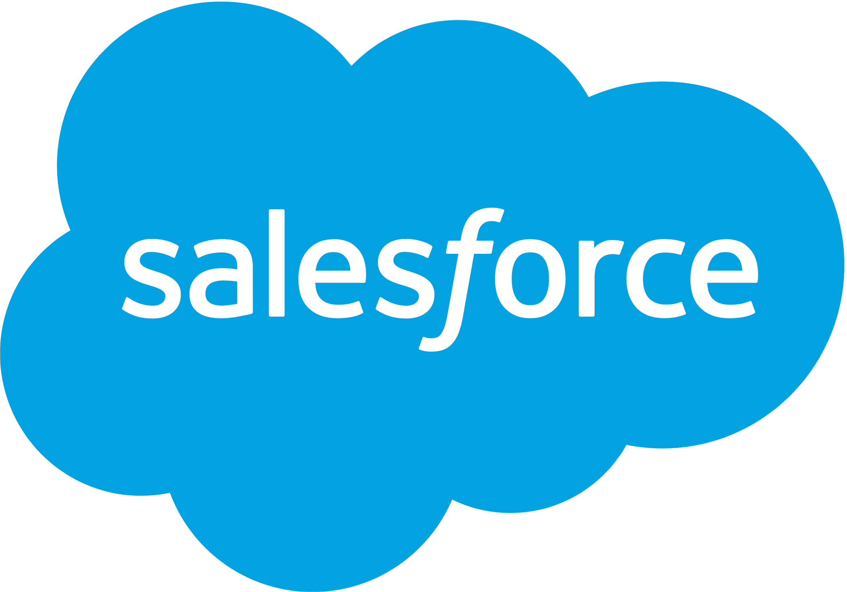







Challenge #1 - Move to the Cloud/SaaS
Business Applications, Data and User Identity are moving rapidly to the Cloud/SaaS
User-Id now involves both on-prem and cloud identity sources &
App-Id should incorporate SaaS applications as well
Azure AD
Google Identity
Notes:
TP
***
Number 1 – Move the Cloud / SAAS
How do you consistently identify your users when the identity is fragmented in so many different identity stores, like Active Directory (on-premises), Okta (cloud), Azure AD (cloud),OKTA,Ping and more? According to ESG report Trends in IAM: Cloud-driven Identities" December 2020, 87% of organizations are already moving or plan to move to cloud-based identity sources in the next 24 months. Put another way, enterprises in this day and age find it difficult to consistently verify users and enforce identity-based security at all times
What you require in this scenario is consistently authenticate and authorize your users regardless of where user identity lives – on-premises, in the cloud or a hybrid of the two. As a result, users can securely access applications and data regardless of their location.
By leveraging the enhanced SaaS Application Hosting Characteristics in App-ID™you can now identify and control SaaS applications that could pose a risk to your organization due to unfavorable hosting characteristics. To help you understand the enterprise readiness of a SaaS application, five new characteristics have been added: certifications achieved, past data breaches, support for IP-based access restrictions, financial viability, and terms of service. Using these characteristics, you can identify and explore the extent of high risk application usage
In addition, the modern applications cannot be secured with the traditional security methods. Lets see why this happens in the next slide

Slide 7

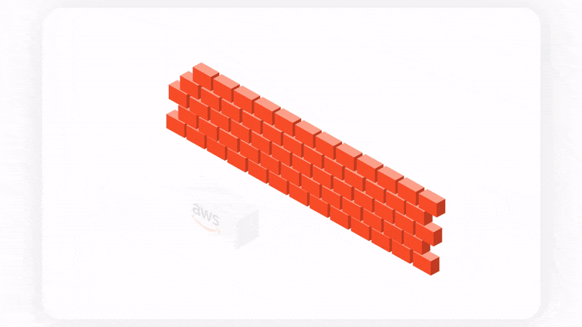
Traditional Port-Based Rules vs Application-based Control
With application-based control, the door can be opened only to specific applications
Notes:
TP
***
Legacy firewalls use port-based rules that are not secure as applications can simply fly under the radar, use non-standard ports, unsanctioned applications and malicious traffic can pass through sanctioned ports (for example port 80 and port 443).
The solution: application based-control: Application-based control is the only way to secure traffic. Port 80 and 443 is open to everything and it’s not possible to know what is coming in, but with application-based control, the door can be opened only to specific applications.
Organizations that use port-based rules today are not secure..
How can applications bypass port-based firewalls?
Some of the methods that applications can use to do this are:
Hopping ports (e.g., an instant messaging app or Skype sneaking across port 80)
Using non-standard ports (e.g., unsanctioned app like Bittorrent using port 80 instead of its standard port)
Using TLS or SSL encrypted traffic
So now that we define App based policies we need our security device to be able to identify those App’s as well right ? and this is what we are going to see on our next slide
Original
********
Customer challenge: Port-based rules
Legacy firewalls use port-based rules that are not secure as applications can simply fly under the radar, use non-standard ports, unsanctioned applications and malicious traffic can pass through sanctioned ports (for example port 80 and port 443).
The solution: application based-control: Application-based control is the only way to secure traffic. Port 80 and 443 is open to everything and it’s not possible to know what is coming in, but with application-based control, the door can be opened only to specific applications.
Organizations that use port-based rules today are not secure..
How can applications bypass port-based firewalls?
Some of the methods that applications can use to do this are:
Hopping ports (e.g., an instant messaging app or Skype sneaking across port 80)
Using non-standard ports (e.g., unsanctioned app like Bittorrent using port 80 instead of its standard port)
Using TLS or SSL encrypted traffic
So now that we define App based policies we need our security device to be able to identify those App’s as well right ? and this is what we are going to see on our next slide

Slide 8

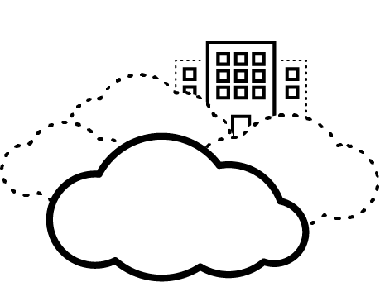
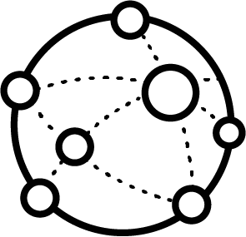
Holistic Application Visibility and Control
NEW
A
B
C
D
E
App-ID
Up to 3300+ App-IDs available
Available as a core functionality
SaaS Security with Machine Learning
15000+ and more App-IDs
Available as Subscription
Enterprise, Internet and SaaS Apps
Enterprise, Internet and many more SaaS Apps
With SaaS Security customers get an expanded set of App-IDs
Notes:
TP **
App ID from Palo Alto networks automatically discover and prevent risks for thousands of new SaaS applications before they become a problem. App-ID™ technology leverages the power of the broad global community to provide continuous identification, categorization, and granular risk-based control of known and previously unknown SaaS applications, ensuring new applications are discovered automatically as they become popular. The SaaS Security catalog delivers granular visibility into applications, their usage within your organization, and their risks
Protect all SaaS applications and secures all traffic—web and non-web. SaaS Security extends the NGFW security services to SaaS applications inline and via API with deep application visibility, segmentation, secure access, and threat prevention. Industry-first inline machine learning (ML) models run on the ML-Powered NGFW, trained by the largest datasets, deliver signatures in under 10 seconds, resulting in a 99.5% reduction in systems infected. These comprehensive capabilities span the on-premises and mobile workforce to stop threats across all applications, resulting in a 45% breach reduction over three years.
Now that we have covered about App visibility lets now drill into the User ID feature

Slide 9







Our Identity Portfolio
User-ID
Multi-Factor Authentication
Credential based attacks
Dynamic User Groups (Link)
Enable users to access apps they need
Always know that the user is who they claim to be
Prevent users from getting phished for credentials
Enable rapid SOC responses with identity context
Notes:
As the needs of our customers have developed over time, so has our offering. By leveraging the information gathered by User-ID our customers are able to utilize capabilities they never had before.
Multi-Factor Authentication (MFA) can be configured to ensure that each user authenticates using multiple methods (factors) when accessing highly sensitive services and applications. For example, you can force users to enter a login password and then enter a verification code that they receive by phone before allowing access to important financial documents. This approach helps to prevent attackers from accessing every service and application in your network just by stealing passwords.
Organizations are increasingly sensitive to the credential phishing threat and often feel powerless to effectively & consistently prevent a successful phishing attack. credential phishing prevention prevents users from submitting their credentials on malicious web pages. Credential phishing prevention works by scanning username and password submissions to websites and comparing those submissions against valid corporate credentials.
Many organizations will hire contractors for a specific time frame to accomplish a well defined project. These contractors may require specific access controls that cover the regions they can operate from, the applications they can access, and even the times that they can access those resources. With Dynamic User Groups (DUGs) Palo Alto Networks can apply policy that limits the specific times that users can access resources. This could limit them to accessing some resources at certain times in the day or automatically stop their access at the time their contract is over. Additionally allow administrators to dynamically change user access or enforce MFA, whether due to new indicators of compromise or a business need, such as granting temporary access to a set of users.
User-ID was first introduced in PAN-OS 3.0. MFA and Credential phishing prevention in PAN-OS 8.0, Dynamic User Groups in 9.1.
Now to solve the problem of securely access applications and data regardless of their location let me introduce here our new Cloud Identity Engine

Slide 10
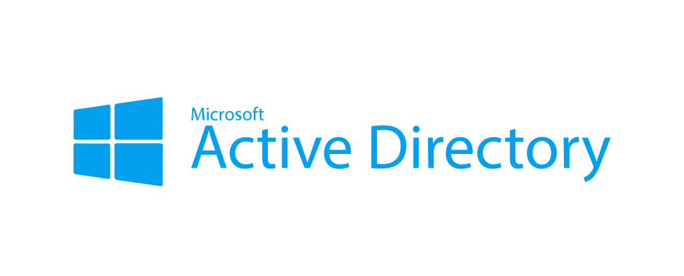





Cloud Identity Engine now expands Identity Sources
On-Prem Identity Provider
Cloud-native Identity & SSO Providers
Azure AD
Google Identity
NEW
Cloud Identity Engine Cloud-native SSO & directory service
Consistently enforce identity-based security
Prisma Access
PA Series
VM Series
Panorama
Notes:
With PAN-OS 10.1, we are moving away to a completely new cloud based architecture for identity with cloud identity engine. This is one place in the cloud that all network security form factors can talk to, and can authenticate and authorize their users against a variety of identity sources, whether they are on-prem or in the cloud or a hybrid scenario.
With this
1) customers will be able to easily authenticate and authorize the users and will be able to adopt identity based policies and move toward zero trust and
2) we will be able to support customers in their transition from on-prem sources to cloud-based identity sources
To empower organizations to move towards Zero Trust, Palo Alto Networks introduces the industry’s first Cloud Identity Engine to:
Easily identity and verify all users across the infrastructure, and achieve Zero Trust. Save time in deployment and management of identity-based controls on your network security infrastructure — using point-and-click configuration with real time validation
Accelerate your transition to cloud-based identity, knowing that your network security infrastructure is future proof. Enable and secure identity irrespective of whether they are using on-prem, cloud hybrid or multi-cloud Identity sources (Idps) with minimal effort.
We are the only vendor that can offer MFA across both cloud applications and an on-prem hosted application enabling MFA authentication across all users and applications. Previously, customers would use PAN MFA for on-prem application and Okta for cloud MFA for cloud applications, now customers can implement and manage MFA from a single point irrespective of on-prem or cloud IDP. Note, we are not enforcing any MFA policies.
Synchronizes user, group and authentication data across all firewall products (Hardware, Virtual, Cloud Delivered, Pandora) from a single point, / Accurately enforce security decisions for all your users at all times, with assured synchronization of all identity-related data in the cloud. Easily apply these controls everywhere in your enterprise: data center, campus, public cloud, branches, and remote users.
Now let’s deep dive to Challenge#2 Evolving and Morphing Attacks

Slide 11
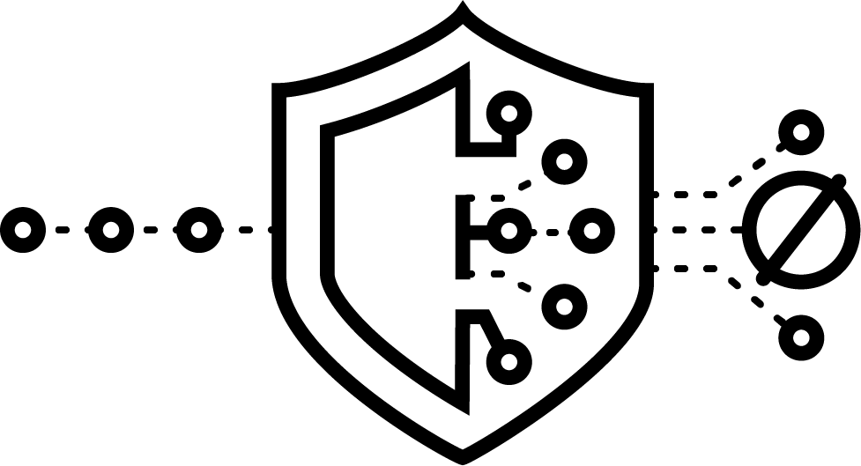

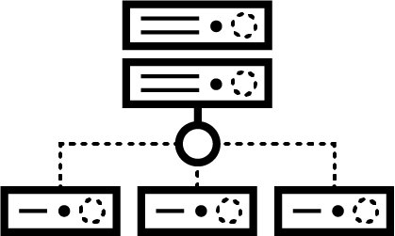






Challenge #2 - Evolving and Morphing Attacks
Modern attacks are evolving and morphing constantly
NGFWs need inline Machine Learning (ML) to deal with unknown threats and morphing attacks
Notes:
We understand the speed is rally the name of the game when we fight against the Modern attacks which are constantly evolving and every seconds become critical.
So Within PAN-OS 10.0 what we are delivering is powered by our Wildfire and URL filtering subscriptions, we delivering that in line-machine- learning at the network level, that is directly on the firewall .
So this is really a signature less approach and it gives us that ability to prevent unknown or weaponized files, credential phishing attack, malicious script, all this instantly without having to hold files or web pages while they are being scanned, and off-course without compromising business productivity .
<Click>
So that really gives us the ability to deliver the preventions instantly, be it on the file side, URL or DNS
We are going to have more rolling up support for more types of analysis on machine learning side but for this initial release in PAN-OS 10.0 those are vectors that we are looking at .
<Click>
Really what we are finding during internal testing has shown that we can stop up to 95% of these new variants of attacks that we have seen via on the file based side or the website that previously would have require a cloud submission to go up to wildfire or URL filtering and to deliver that verdict .
But again, now we can do that in real time on the firewall, saving that time, preventing that initial patient 0 that our customers are always been asking us about.
What makes all this possible is that real world data the robust cloud analysis that we are doing and that’s really why even though these machine learning model are delivered on the firewall or on the hardware itself they do require the URL and Wildfire subscriptions.
Now allow me to introduce the new ML powered NGFW and also brief you about the new features that we offer in the ML powered NGFW

Slide 12








ML-Powered NGFWs from Palo Alto Networks
Instant protection from threats using ML
Near real-time protection via signatures
Complete, natively integrated IoT security
Automatic policy recommendations
Up to 95% of unknown file- and web-based threats prevented inline
<10 second signature delivery, resulting in 99.5% reduction in systems infected
3x IoT devices detected
99% of breaches are caused by misconfiguration, according to Gartner
Notes:
TP
****
Introducing the first and only ML-Powered NGFW—enabling you to prevent unknown threats, see everything, including IoT, and reduce errors with automatic policy recommendations.
With PAN-OS 10.0, we are changing the game by making network security proactive and intelligent with the world’s first ML-Powered NGFW.
For the first time ever, ML is embedded in the core of the NGFW to prevent up to 95% of new variants of known threats as well as new threats.
For the rest of the attacks that do need to be analyzed in the cloud, as soon as protections are created, they will flow to all firewalls worldwide with zero-delay signature updates.
For the first time ever, organizations will have a turn-key solution that combines machine-learning for accurate device discovery and risk assessment with native policy enforcement, and this won’t require the deployment of any additional sensors beyond the NGFWs
The ML-Powered NGFW uses machine learning to analyze vast amounts of telemetry data, and then recommend policies. With PAN-OS 10.0 and IoT Security, customers will be able to view and adopt the IoT Security policy recommendations for safe device behavior. This will save time, reduce the chance of human error, and help secure IoT devices.
Now that we have seen the first two challenges lets focus on the third challenge which is Multi point products proliferation
Original
********
With PAN-OS 10.0, we are changing the game by making network security proactive and intelligent with the world’s first ML-Powered NGFW.
For the first time ever, ML is embedded in the core of the NGFW to prevent up to 95% of new variants of known threats as well as new threats.
For the rest of the attacks that do need to be analyzed in the cloud, as soon as protections are created, they will flow to all firewalls worldwide with zero-delay signature updates.
For the first time ever, organizations will have a turn-key solution that combines machine-learning for accurate device discovery and risk assessment with native policy enforcement, and this won’t require the deployment of any additional sensors beyond the NGFWs
The ML-Powered NGFW uses machine learning to analyze vast amounts of telemetry data, and then recommend policies. With PAN-OS 10.0 and IoT Security, customers will be able to view and adopt the IoT Security policy recommendations for safe device behavior. This will save time, reduce the chance of human error, and help secure IoT devices.

Slide 13

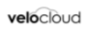
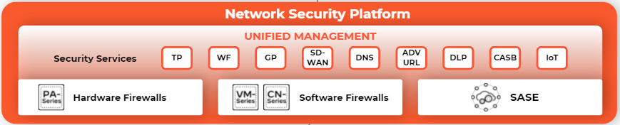



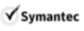
Challenge #3 - Multiple Point Products Proliferate
Multiple point products required to achieve security posture
Platform approach with natively integrated services
Notes:
TP
**
All of these capabilities have sprouted up in order to stop the adversary from exploiting the organization using different vectors, whether its targeting the endpoint, targeting the server, targeting the end user, coming over email in the form of a malicious web link or file attachment and so on.
It’s resulted in vendors focused on trying to address each one of those point problems separately
In fact, Momentum Cyber. which tracks the cybersecurity landscape, cited over 3500 independent cyber security vendors in the security landscape in mid-2020
<Click>
Palo Alto Networks solves this problem now and will continue to do so in the future by being able to span all those different use cases that appear on the left, with those requirements and outcomes delivered at a very easy to activate, integrated way that doesn't introduce any security gaps
If fact, at a holistic level, we deliver comprehensive visibility and controls to cover all of their security gaps, and at the same time, enabling a very delightful user experience
And that last point is key. the Security is not getting in the way of users but It is just running silently in the background, keeping users safe.
Now lets talk about the Platform approach that we mentioned in this slide and how it delivers best in class security

Slide 14


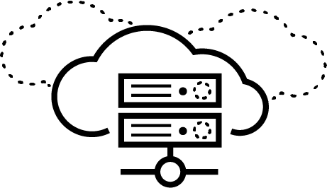









Our network security platform delivers best-in-class security
Best-in-class security for all users and applications
Internet
Private Cloud / DC
Public Cloud
SaaS Applications
Integrated security services across hardware, software and SASE
Network Security Platform
UNIFIED MANAGEMENT
Security Services
TP
WF
GP
SD- WAN
DNS
ADV
URL
DLP
CASB
IoT
Optimized end-user experience at all locations
Hardware Firewalls
Software Firewalls
SASE
Unified security operations
HQ
Branch Office
Mobile
Home
Notes:
TP
****
Regardless of the form factor that we offer *** Hardware which includes PA-Serie *** Software form factor ,like VM-Series and CN-Serie or Cloud series that is Prisma Access, all of these form factors consume our subscription services – that includes , TP, URL, WF, DNS, IOT, DLP, Prisma SaaS...with more to come!
Palo Alto Networks use the unique approach of offering these security capabilities as cloud-delivered services.
Unlike the rest of the industry, we recognized that a cloud based architecture would give us the advantages like
The power of the services comes down to the integration, which drives better security outcomes.
And for this reason, we believe native integration is a fundamental requirement to all our security services, because it makes each security capability inherently better with that integration.
Original
**********
Lee feedback
Insert in the talk track: we are uniquely able to deliver enterprise grade services for the hybrid workforce, platform to do it across HW, SW and SASE, continue to innovate,
[make sure you address all the problems that were highlighted in the prior slides]
NetSec has two major use cases - X% of the market is addressing the 'Internet' use case and the rest is addressing a 'Data Center' use case
To protect the 'Internet' use case, Enterprises traditionally used Hardware Firewalls but now the market is moving to SASE. As that happens, SASE is growing at 3x the rest of the market TAM
To protect the 'Data Center' use case, Enterprises used to deploy big firewalls, but as the world becomes virtual, they are moving to VM-Series and Prisma Cloud
As the world transitions from hardware to other form factors, we provide SASE, VM-S and PC. Our competitors do not.
Lastly Nir also suggested showing that CDSS is not only hardware linked but will increasingly be a part of XDR and PC sales too. Given the size of the services, he said it is important to show their relevance beyond hardware

Slide 15
Security Services: Best-In-Class Security, available for all enterprise locations
Core Security Services
Leading IPS solution that blocks 100% of evasions with Threat Prevention
Industry only realtime prevention for unknown and known malware with with WildFire
Reinvented web security now stopping 40% of unknown malicious URLs that others cannot with Advanced URL Filtering
Most comprehensive DNS security, preventing 36% more threat types than competitors
IoT Security
Industry’s only ML-powered visibility, prevention, and enforcement
Protects 1 in 5 US hospitals and holds Industry awards In IoT for Enterprise verticals
15X to 20X deployment time savings with the NGFW platform
Data Security
Most comprehensive cloud-delivered enterprise DLP that consistently protects sensitive data across networks, clouds and users
Industry only integrated CASB that automatically provides visibility and control to new applications
Lowest TCO compared to legacy DLP and CASB, with widest range of deployment
Network Security Platform
Best-in-class security efficacy in the industry with 4.3m updates daily and 100% of evasions blocked in testing
Consistently available across all form factors (hardware, software and SASE) providing 45% reduced risk of a breach
Instant protection powered by ML for zero-day threats with crowdsourced protection contributed from 80k customers
Notes:
Industry recognized (Gold Globee, IoT Evolution product of the Year, leading in Gartner report)

Slide 16
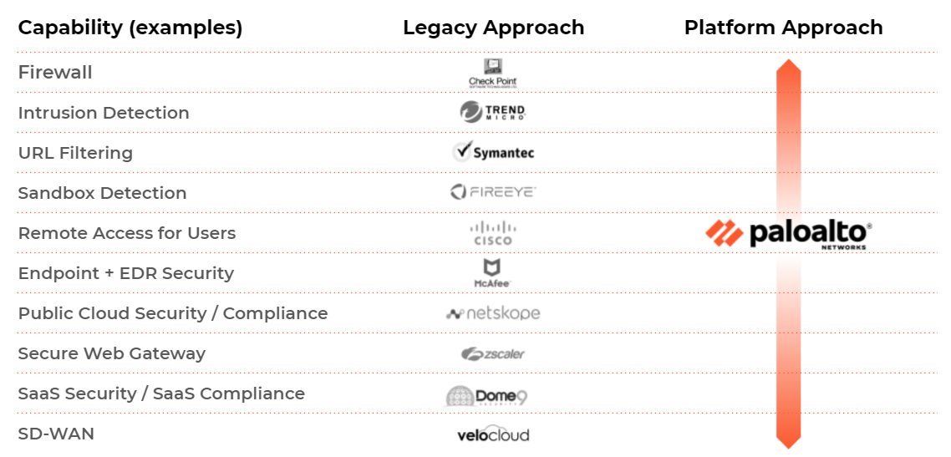
Integrated Platform Approach Consolidates Security
45% Reduced Risk of a Security Breach*
30% Faster to Proper Security Posture*
$9.9M Security Infrastructure Cost Savings*
*Forrester CDSS Spotlight
Notes:
This slide is to show you one layer deeper about the multi-vendor approach in the industries Vs Palo Alto networks Platform Approach.
One of the key differentiators I would like to highlight here is our NGFWs that is ours Platform Solution versus Point Products from competitors.
What advantage does this bring to the customer ?
Well, if you look, this sperate multi vendors drives up many cost including product & licensing costs, operational costs and human capital costs and importantly not only cost but the ability to be proactive in responding to security incidents is restricted.
Here, Palo Alto Networks allows you to consolidate technology categories to lower down overall operational costs and improve overall security along with delightful user experience as I mentioned earlier.
Palo Alto Networks commissioned Forrester Consulting to conduct a Total Economic Impact™ (TEI) study to examine the value that enterprises could achieve by deploying Palo Alto Networks for network security .By the way this TEI goes beyond the traditional total cost of ownership (TCO) and ROI analyses.
45% Reduced Risk of a Security Breach*
Each of the Palo Alto networks Cloud-Delivered Security Services seamlessly integrates with and enhances the capabilities of the ML-Powered (Machine LearningPowered) NGFW deployment, improving network security coverage and capabilities while protecting the entirety of the attack surface. When a data breach happens, organizations must deal with a myriad of costs. Palo Alto Networks Cloud-Delivered Security Services help prevent the incident from happening from the onset, which also helps mitigate any follow-on costs that might occur
30% Faster to Proper Security Posture*
Organizations experienced reduced deployment and fine-tuning times with Palo Alto Networks. Native integration with the NGFW, VM-Series, and Prisma Access deployments and complementary management capabilities made it easier for organizations to reach steady state for their security solutions.
$9.9M Security Infrastructure Cost Savings*
With Palo Alto Networks Cloud-Delivered Security Services, organizations can rationalize and remove a large portion of their legacy security stack, reducing the number of vendors in their environment and the number of security licenses needed to protect their networks.
So now that we have talked about the Platform approach lets see the high level architecture of the Palo Alto Networks Next Generation Firewall

Slide 17
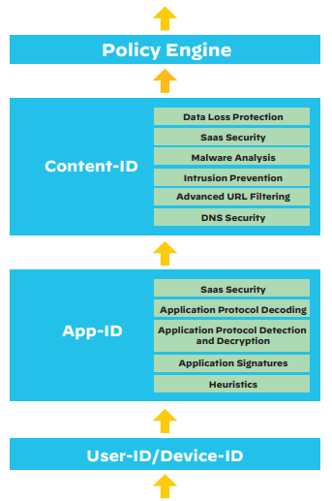
Delivering Predictable Performance with Services Enabled
Palo Alto Networks ML-Powered NGFWs are built with Single Pass Architecture
Scan all Security Functions in a ‘Single Pass‘
Add Services with no additional performance impact
Predictable performance when using services
Learn more
Scan it All, Scan it Once
Notes:
Palo Alto Networks next-generation firewalls are based on a unique Single Pass Parallel Processing (SP3) Architecture – which enables high-throughput, low-latency network security, even while incorporating unprecedented features and technology
Palo Alto Networks Next-Generation Firewall is empowered with Single Pass Software, which processes the packet to perform functions like networking, user identification (User-ID), policy lookup, traffic classification with application identification (App-ID), decoding, signature matching for identifying threats and contents, which are all performed once per packet.This processing of a packet in one go or single pass by Palo Alto Networks Next-Generation Firewall enormously reduces the processing overhead
Palo Alto Networks Parallel Processing hardware ensures function-specific processing is done in parallel at the hardware level which, in combination with the dedicated Data plane and Control plane, produces stunning performance results
Another important security roadblock which we face is securing encrypted traffic

Slide 18

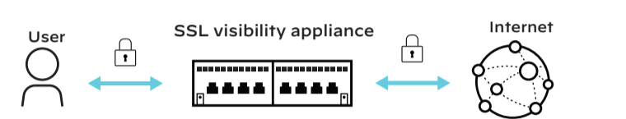

ML-Powered NGFW: Decrypting and Securing Network Traffic
Encrypted traffic is now the norm
Decrypt & Secure it on the NGFW
>90%
Antivirus
URL filtering
Anti-spyware
Sandboxing
of internet traffic today is encrypted
Data loss prevention
Phishing prevention
File blocking
IPS
2016
2020
Security Services need visibility into encrypted traffic
Source: Google Transparency Report
Notes:
Encryption is the new normal. About 95% of enterprise traffic is now encrypted.
This rise in encryption makes it critical for enterprises to have visibility and control within encrypted traffic as malware can easily evade security measures by hiding in encrypted data.
This new release of PAN OS allows you to decrypt TLS 1.3, addresses the difficulty in deploying and maintaining decryption, and increases visibility so you can decrypt safely and efficiently
So now that we have a high-level overview of the architecture and also saw the new normal of encryption lets look at some data around the Palo Alto firewall

Slide 19
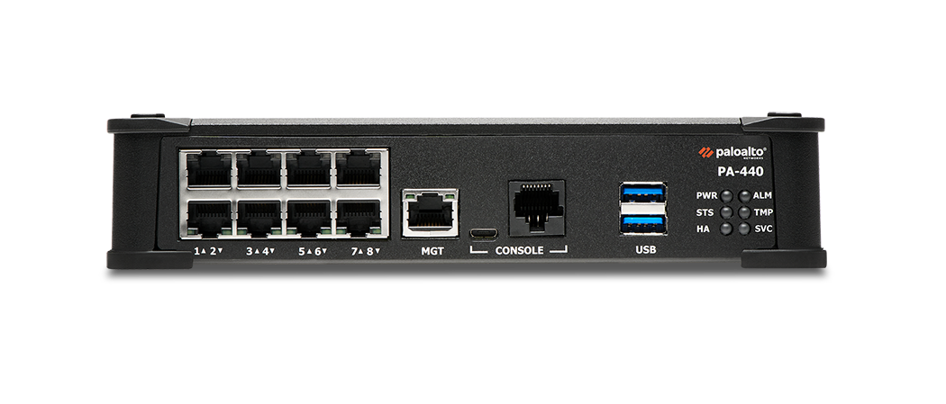
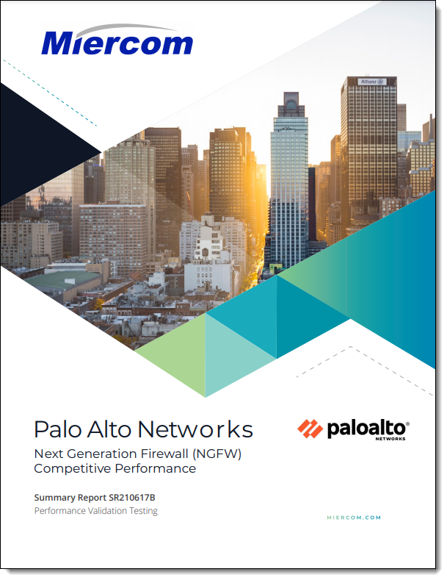
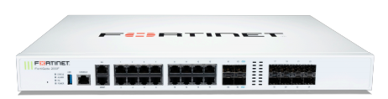
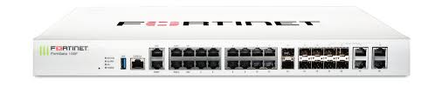
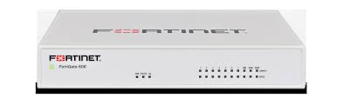
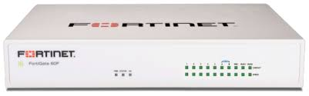
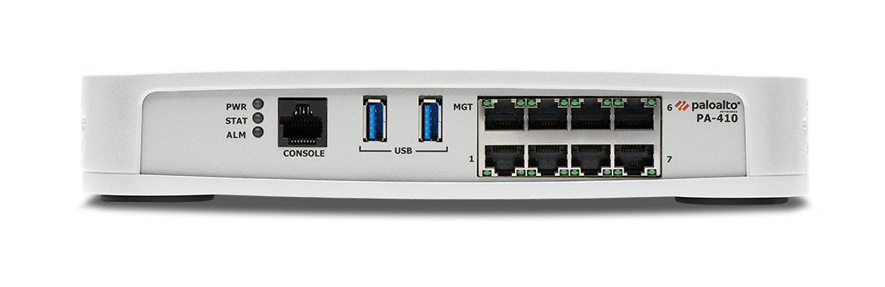
Independent Validation - Superior Performance with Services Enabled
Validated by 3rd party Industry Report on NGFWs
1.8x Perf
2.1x Lower TCO
Fortinet FG 201F
PA-460
6.6x Perf
9.4x Lower TCO
PA-450
Fortinet FG 101F
3.4x Perf
5.9x Lower TCO
Fortinet FG 81F
PA-440
Comparing Throughput and TCO with and without Services Enabled
5.3x Perf
6.9x Lower TCO
Fortinet FG 61F
PA-410
PA-400 Series performance is up to 6x better than Competitor with services enabled
PA-400 Series offers up to 9x lower Total Cost of Ownership per protected Mbps
Notes:
Here is the data so to speak.Miercom performed independent validation testing to compare the throughput and TCO with and without security services enabled.
There were 3 key findings of the testing
Palo Alto Networks saw upto 6X higher throughput across all parameters tested, including application traffic
On Single application test Palo Alto Networks PA-400 series performance shows consistently low degradation when services are enabled with average of 8%
Palo Alto Networks showed higher performance and lower cost for every appliance compared to similar products with cost per Mbps upto 9X lower
So now that we have seen the data around Palo Alto networks ML powered NGFW lets now see the different form factors that are offered serving different use cases
Link to the report
https://start.paloaltonetworks.com/security-without-compromise.html

Slide 20
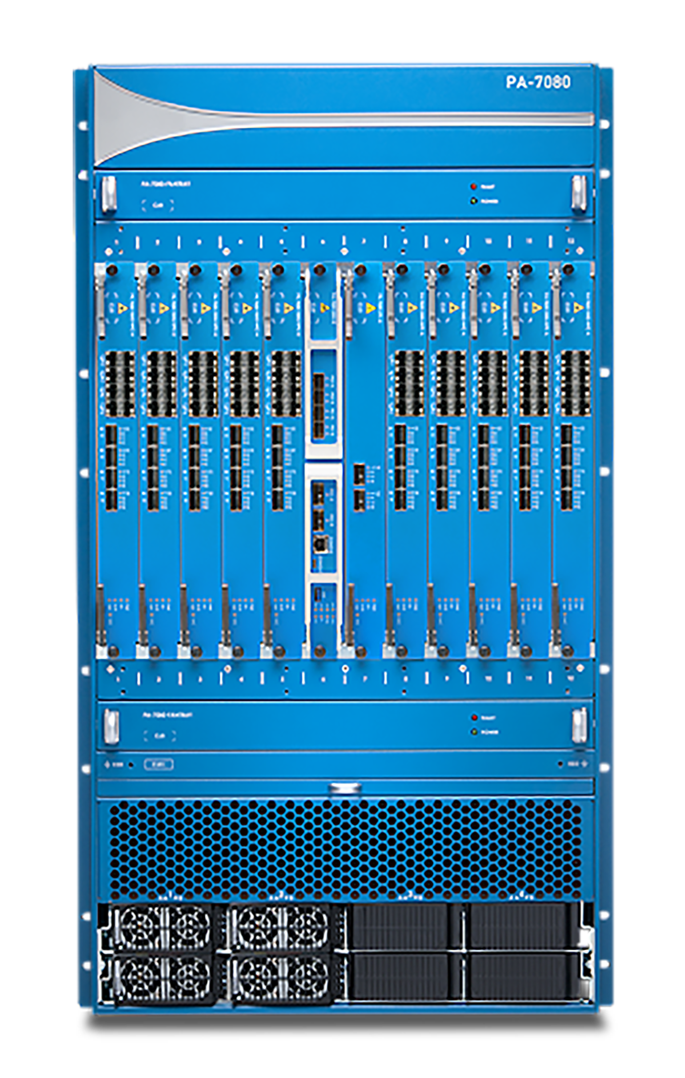
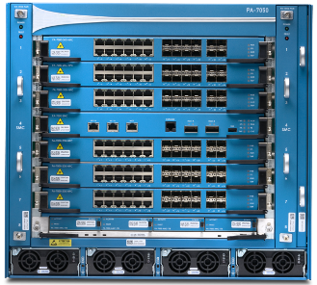
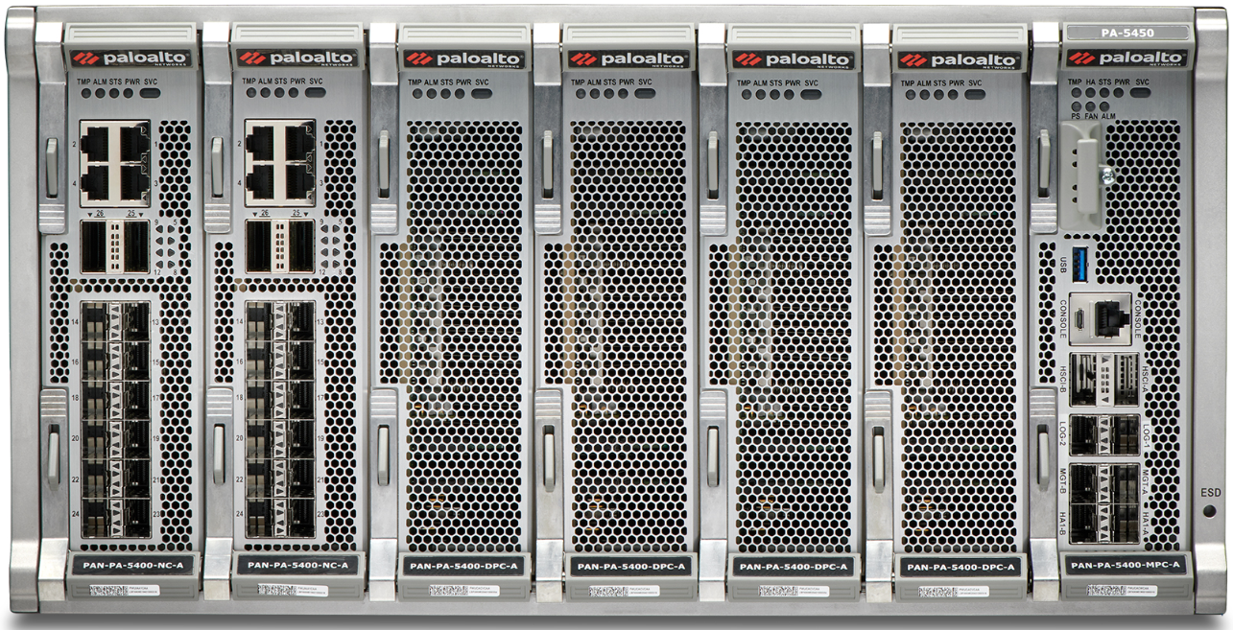
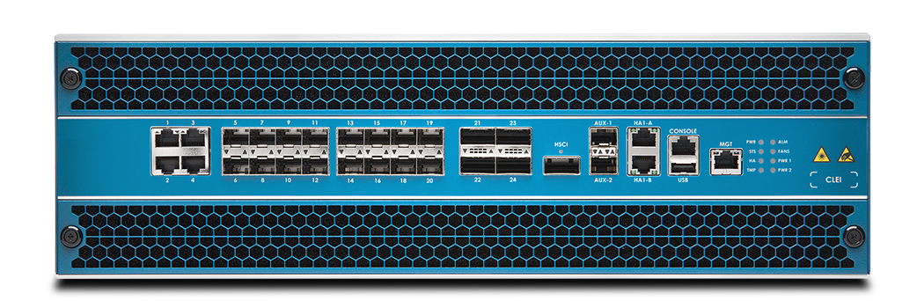
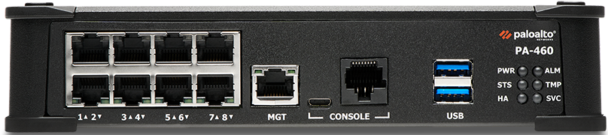
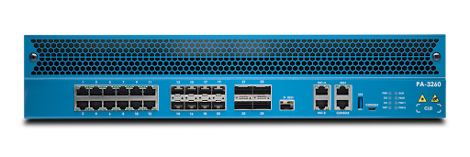
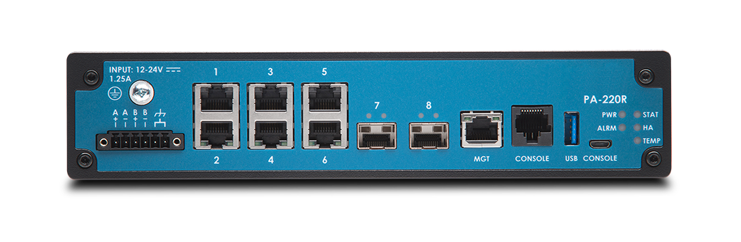
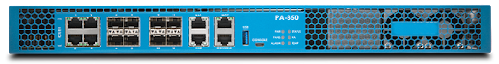
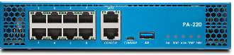
ML-Powered NGFW Form Factors - Purpose Built Hardware
PA-7000 Series
PA-5450
PA-5200 Series
PA-400 Series
PA-3200 Series
PA-220R
PA-800 Series
PA-220
Small Branches & Remote Locations
Network Perimeter
Hyperscale
Data Centers
Notes:
The foundation of our Network Security Platform are the form-factors of firewall that we offer.
Small Branches & Remote Locations – PA Series out of this 220 – Branch offices,Retails locations,midsize business,220r – Severe environments : Utility substations,Manufacturing plants,Oil and Gas facilities,healthcare networks,800- Midsize business,Branch offices
Network Perimeter – PA 3200 Series – Internet Gateways
Hyperscale Data Centers – PA 5K and 7K Series.Large datacenters,high bandwidth network perimeter
And most importantly, all of this is managed centrally by Panorama.
So now that we have seen the different form factors available let us know focus on the new Licensing feature of the PANW firewall

Slide 21

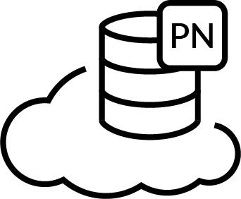











ML-Powered NGFW Form Factors
Software Firewalls delivered as single flexible and scalable SKU
Key Attributes
Credit-based Licensing
Flexible Firewall Sizing
A la Carte Security Services & Panorama
Simplified Procurement Process & Resource Tracking
VM Panorama Management
VM Panorama Log Collector
Cloud-delivered Security Services
Consume all with Software NGFW Credits
Software Firewalls
Notes:
TP
***
Now procurement and deployment of PANW firewall can be based on actual and immediate needs. Customers purchase Software NGFW Credits, which can then be allocated to VM-Series virtual and CN-Series container next-generation firewalls (NGFWs), cloud-delivered Security Services, and VM Panorama for management and log collection. The process just takes three simple steps:
Procure Software NGFW Credits.
Allocate or reallocate credits across different deployments to activate your choice of security products and your choice of security services in just minutes.
Manage and monitor credits via the Palo Alto Networks customer support portal.
As needs change over time, Software NGFW Credits can be reallocated to new and other firewall-as-a-platform solutions without having to go through additional procurement cycles. This flexible purchasing and deployment approach can substantially save time and money, while improving scalability and providing the agility needed to tailor security controls to your current security needs.
Moving ahead lets go ahead and learn about the Central Management and Visibility feature provided by the Panorama for PANW firewalls

Slide 22






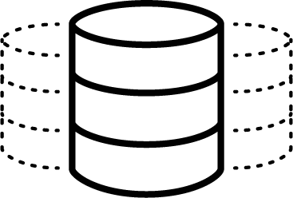

Panorama - Centralized Visibility and Management
Headquarters
Private Cloud
Panorama
Mobile Users
Public Cloud
Branch
Data Center/ Hybrid Cloud
Centrally manage your security
Gain visibility into your network
Simplify your operations
Notes:
TP
***
It doesn’t matter where you firewalls are, what form factors they are in or what subscriptions are running on them, Panorama can manage all of it.
<Click>
Panorama™ saves time and reduces complexity by managing network security with a single pane of glass for all your Palo Alto Networks firewalls irrespective of their form factor, location or scale.
<Click>
You can Centrally Manage Configuration, device lifecycle and network security configuration for all firewall form factors in one unified UI
<Click>
Gain Visibility into your network. Obtain deep visibility, monitor network traffic and security threats with Application Command Center (ACC), reporting, and detailed log views
<Click>
Simplify Operations by streamlining configuration sharing with templates and device groups. Scale log collection as logging needs increase.
I can very well understand that this information was a lot to chew on and you have been listening to me talk for the last 30 mins.But I have just 3 short slides to show why Palo Alto Networks I a leading Cybersecurity company
Original
********
Panorama™ provides a centralized network security management solution for all your Palo Alto Networks firewalls. Whether they are hardware, virtual machines or cloud delivered firewalls and in any location.
Manage Configuration - Centrally manage devices and security configuration for all groups of firewalls across all form factors and locations
Visibility into network and security - Panorama provides centralized visibility and comprehensive insights into your network traffic, logs, and threats
Simplified Operations - Reduce administrative workload by helping manage updates, automating threat responses through policy-based actions, and utilize API-based integrations with third-party systems

Slide 23



PanoramaTM Centralized Management of Distributed Enterprises Massively simplified security at thousands of enterprise branches
Simplifies deployment of large numbers of firewalls with Zero Touch Provisioning
Centralize Branch Network Security Management and Configuration
Enforce uniform policies across the entire distributed enterprise
Panorama
HQ
Notes:
Panorama™ network security management, simplifies management tasks while delivering
comprehensive controls and deep visibility into network-wide traffic and security threats.
And it Reduces complexity by simplifying configuration, deployment and management of your Palo Alto Network security
products.

Slide 24






14 Years of Industry Firsts
Selected List
Wildfire
Prisma Access
First IoT Solution Fully-Integrated with NGFW
First In-line ML-based Web Protection
First NGFW
First Cloud-Delivered Sandbox
First Cloud- Delivered NGFW
First ML- Powered NGFW
2007
2014
2020
2021
First Cloud-Delivered Security Services
First Cloud-Delivered Security Services
First Containerized NGFW
First Cloud-Delivered Enterprise DLP
First SaaS Security Solution to Automatically Discover and Control Applications
Powered by PAN-OS
Notes:
(Anand’s all-hands version)
This slide really reflects the NGFW journey where you see multiple industry firsts benchmarked just to show the disruptive approach of PANW
The Palo Alto Networks NGFW journey has been a journey of continuous innovation and expansion of coverage as the market and technologies evolved. The continuous innovation brought new capabilities such as User-ID, Content-ID, Device-ID after App-ID. More recently we came out with credential theft prevention, DNS Security, secure SD-WAN, and IoT security.
As the perimeter evolved, we helped customers leverage network security in every place and location - e.g. public and private cloud with VM-series and CN-series firewalls and also as a hosted service for users in HQ, Data Center, remote branches or working from home. Through, the years we have continued to leverage the cloud scale for the best-in-class security delivered to a robust NGFW platform that can be deployed anywhere with a variety of form factors

Slide 25

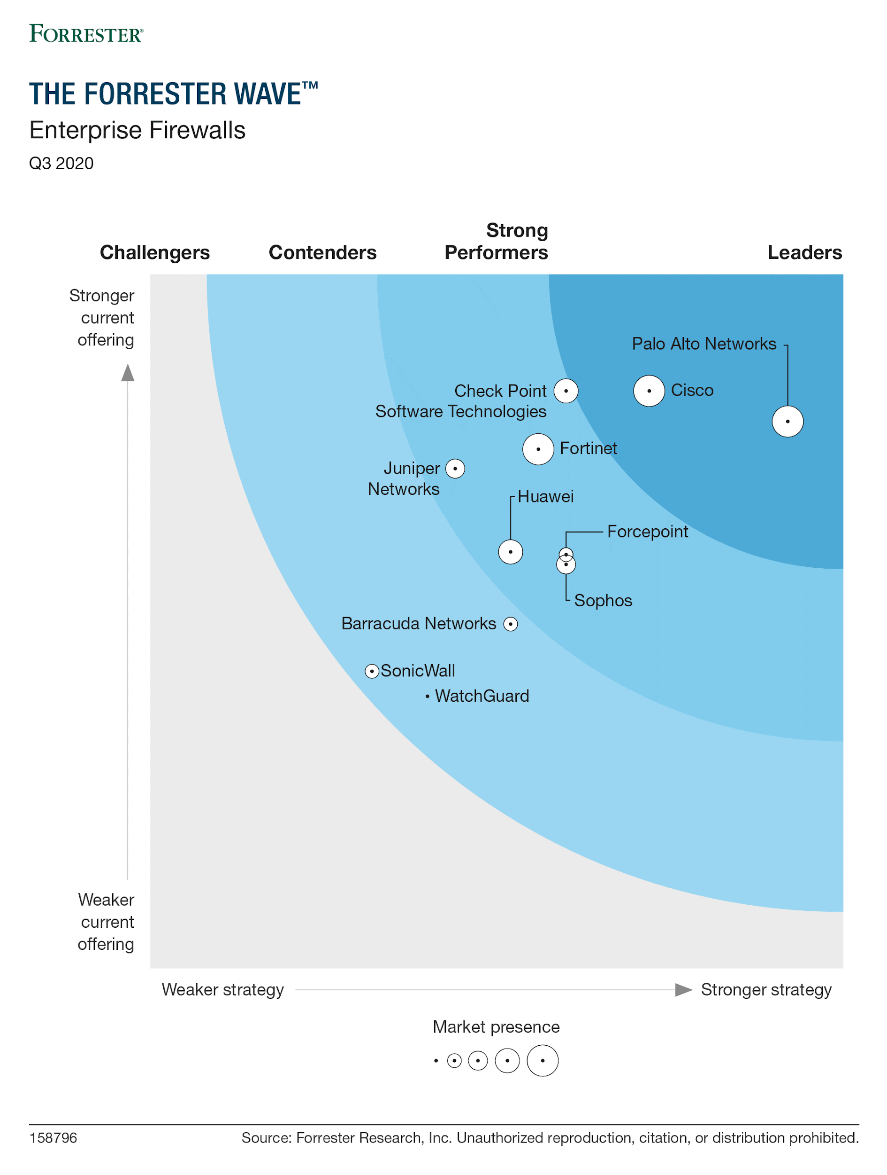
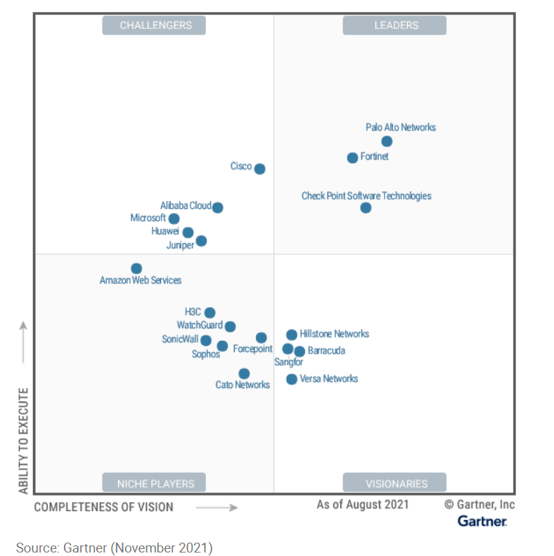
Industry Recognition as a Leader in Firewalls
Recognized as a LEADER in the Gartner 2021 Magic Quadrant: Network Firewalls
Recognized as a LEADER in the Forrester Firewall Wave™: Enterprise Firewalls Q3’20 Report
This graphic was published by Gartner, Inc. as part of a larger research document and should be evaluated in the context of the entire document. The Gartner document is available upon request from Palo Alto. Gartner does not endorse any vendor, product or service depicted in its research publications, and does not advise technology users to select only those vendors with the highest ratings or other designation. Gartner research publications consist of the opinions of Gartner’s research organization and should not be construed as statements of fact. Gartner disclaims all warranties, expressed or implied, with respect to this research, including any warranties of merchantability or fitness for a particular purpose.
Notes:
And this slide is to show you the recognition of Palo Alto Networks as a Leader in firewalls.
Gartner’s Magic Quadrant 2021 and also the Forrester Firewall Wave Q3 2020 report as shown here which shows Palo Alto Networks firewalls as a leader

Slide 26



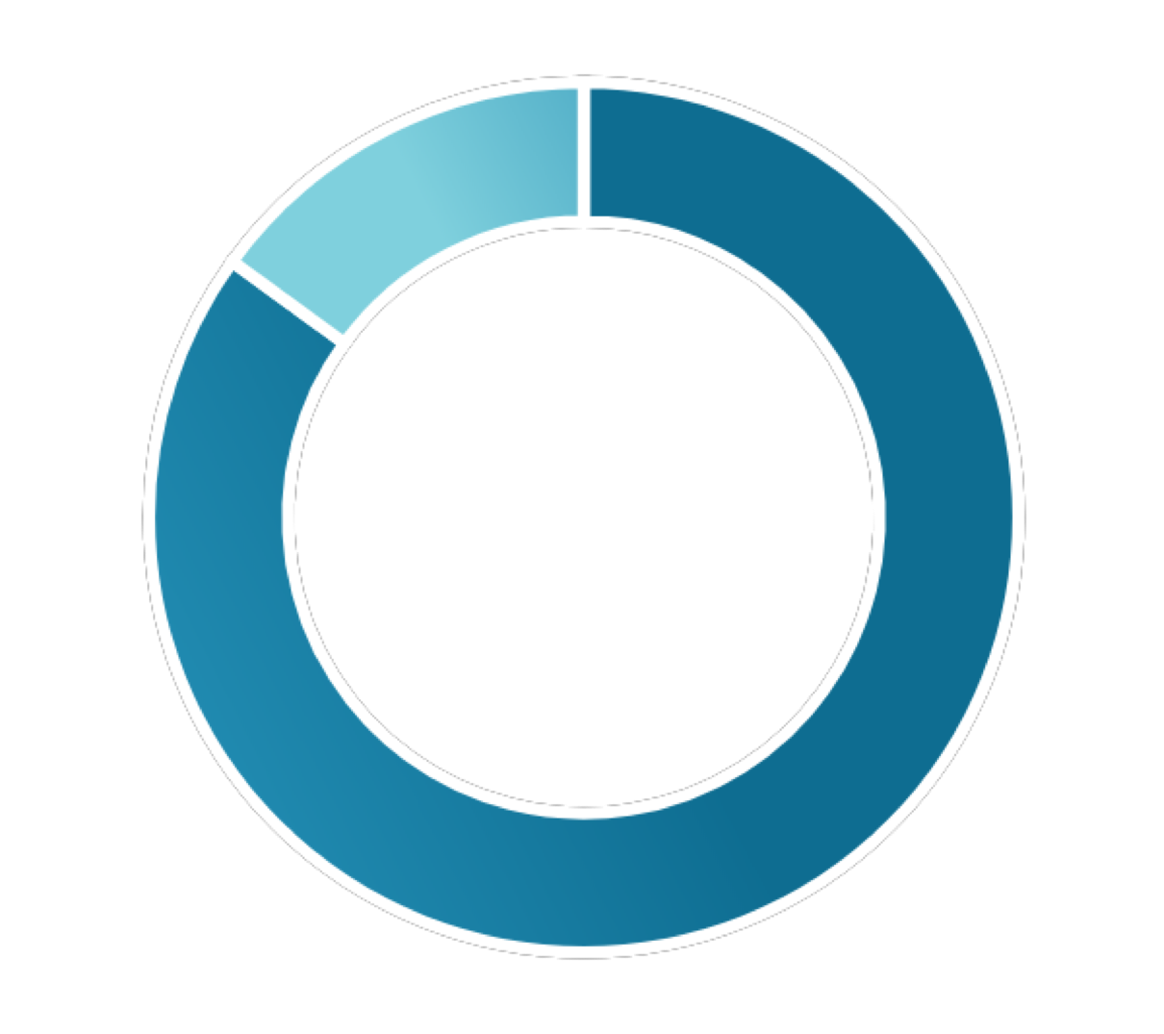

The World’s Leading Cybersecurity Company
95
#1
75,000
of Fortune 100 Rely on Palo Alto Networks
in Enterprise Security Revenue trend 22% CAGR
FY18 ‒ FY20
Customers In 150+ Countries
FY18
FY19
FY20
71% of the Global 2K
Are Palo Alto Networks Customers
15% Year-Over-Year
Revenue Growth
18% Year-Over-Year
Revenue Growth
9/10
Average CSAT Score
Gartner, Market Share: Enterprise Network Equipment by Market Segment, Worldwide, 4Q19, 20 March 2020
Notes:
And I would say, this slide really reflects our acceptance in the industry
As you can see, 95 of fortune 100 companies rely on palo Alto networks for security.
We are number one in enterprise security with a good revenue growth year on year and we have more then 73 thousands customers in 150+ countries across the globe.
All this will make us The World’s Leading Cybersecurity Company.
So this is all the content I had to share with you.Now lets move on to the next exciting part of this session which is the Hands on Lab

Slide 27

ML-Powered NGFW Hands-on Workshop
Notes:
Okey, so we are at the most existing part of our session.
Let me tell you about the LAB

Slide 28

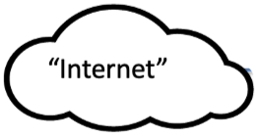


UTD ML-Powered NGFW Lab Networks Overview
Mobile-PC
(GlobalProtect)
10.160.1.201
Mobile-PC
(Clientless VPN)
10.160.1.202
LAN
192.168.11.201
WAN
172.16.1.1
ethernet 1/1
LAN
192.168.11.1
ethernet 1/2
Student Desktop
Management
10.30.11.1
Management
10.30.11.201
Server
172.16.1.101
Notes:
This is the setup of your LAB, each of you will get a dedicated POD to work on.

Slide 29
UTD ML-Powered NGFW Lab Activities
Activity 0 – Log in to the UTD Workshop
Activity 1 – Granular Control on Social Media and Enabling Sanctioned SaaS Applications
Activity 2 – Applications on Non-standard Ports
Activity 3 – Policy Optimization
Activity 4 – Decryption
Activity 5 – Modern Malware Protection with ML-Powered Analysis
Activity 6 – ML-Powered URL Filtering
Activity 7 – GlobalProtect: Safely Enable Mobile Devices
Activity 8 – Control Application Usage with User-ID
Activity 9 – GlobalProtect Clientless VPN
Activity 10 – Cloud Identity Engine
Activity 11 – ACC and Custom Reports
Activity 12 – Feedback on Ultimate Test Drive
Notes:
And on this setup you are going to perform these 12 activities.
Well, technically 11, last but not the least and very import for us is your valuable feedback about this session.
Let me brief you about these activities so you will get some idea about it.
Activity 0 is guide you how to login to the lab porta and how to use cloud share portal for your LAB
Activity 1 is to learn how you can do the granular SaaS application control with our firewall.
Activity 2 is to see the effect of service any verses service application default and see in action how it will force the use of standard application port
Activity 3 is on policy optimizer; this is one of the cool feature that we have announced part of our PAN-OS 9.0
You will lean how easy it is to convert the port based legacy rule to application-based rule with just a few click.
Activity 4 is about the decryption. In this you will create a policy for selective applications to decrypt and protect from malware propagation
Activity 5 is to learn about the stings of our ML powered analysis to protects against the modern malware.
Activity 6 is to lean about the stings of ML-Powered real-time analysis of Phishing and Javascript exploit using URL filtering.
Activity 7 is about the Global protect. And learn how you can safely enable mobile device. And block the GlobalPortect user attempts to connect to GlobalProtect gateway if user device is identified as compromised and has been quarantined.
Activity 8 is to lean about the user-id and how you can control the application usage with it
Activity 9 is to learn about clientless VPN
Activity 10 is provides information on the Cloud Identity Engine which provides both user identification and user authentication
Activity 11 is to understand the built-in visualization tools which is ACC and lean different reporting features in the firewall .
And last but not the least activity 12 is feedback.
Kindly spend your few minutes after your LAB or before you logout to provide your feedback from the survey link in your Cloud share LAB portal.

Slide 30
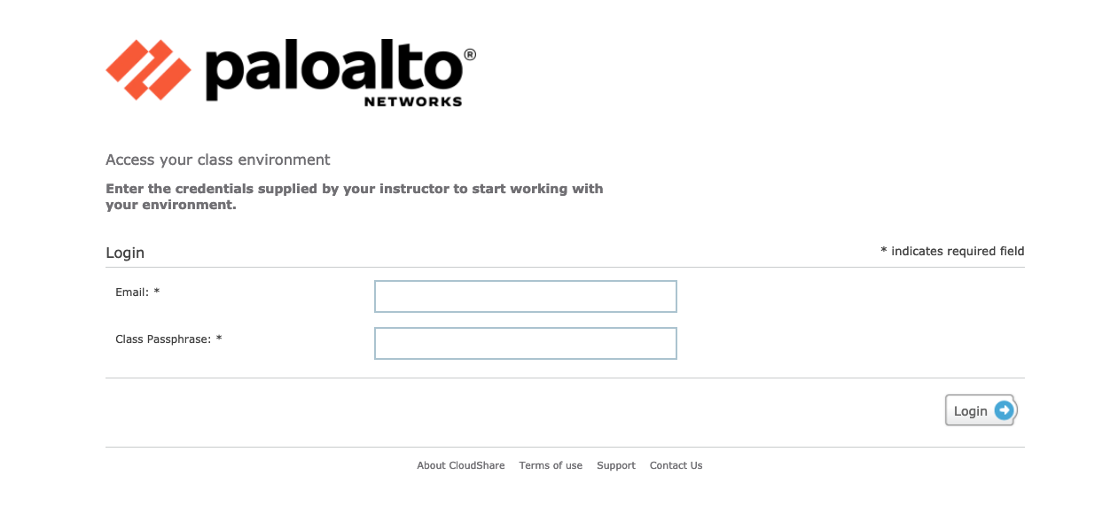
Log in to the UTD Workshop
Log in to the workshop environment
Login Link
https://use.cloudshare.com/Class/4s1lw
Passphrase
palo alto networks
Notes:
Here is your LAB access details. Let me share that in our chat window.

Slide 31
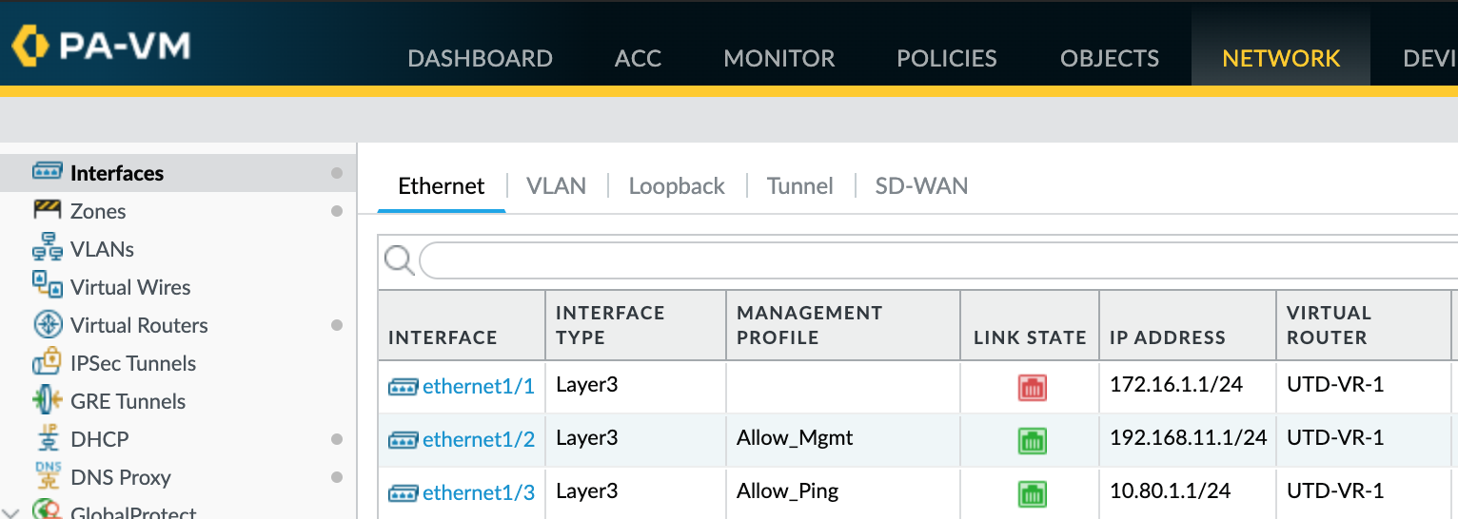
Activity 0: Bring Up the Firewall Interface
Activity-0 Task 4: Very Important – Bring up interface “ethernet1/1” to connect the firewall to the internet.
Notes:
In this activity, most importantly you are going to bring up the firewall interface E11/1 and commit the changes.

Slide 32
Activity 1: Granular control on Social Media and Enabling Sanctioned SaaS Applications
Scenario: Every organization is trying to determine how to appropriately control social media and SaaS (Software as a Service) applications. Allowing them all is highly risky, while blocking them all can cripple the business.
Policy considerations: who can use social media and SaaS applications, what are the risks of data loss/data transfer, and how to eliminate the propagation of malware
PAN-OS features covered in this activity:
App-ID and function control
Logging and reporting for verification

Slide 33
Activity 2: Applications on Non-Standard Ports
Scenario: Limit the use of remote access tools to IT and support; enforce the use of standard port
Policy considerations: Control what port should the application be allowed through the firewall
PAN-OS features covered in this activity:
Logging and reporting to show SSH on non-standard ports
App-ID, application group and applications-default service (port)
Logging and reporting for verification

Slide 34
Activity 3: Policy Optimizer
Scenario: If you just migrated your port-based policies to Pan-OS, you may still have many port-based policies in your Pan-OS configuration. Policy Optimizer identifies port-based rules and help you to convert them to application-based policies
Policy considerations: which applications to be whitelisted and how best to implement them without compromising application availability
PAN-OS features covered in this activity:
Policy Optimizer
App-ID, application group and applications-default service (port)

Slide 35
Activity 4: Decryption
Scenario: More and more traffic is being encrypted with SSL by default. This makes it difficult to allow and scan that traffic, yet blindly allowing it is very risky. Policy-based SSL decryption allows you to decrypt applications, apply security policy, then re-encrypt and send the traffic to its final destination.
Policy considerations: Which applications to decrypt and protect from malware propagation
PAN-OS features covered in this activity:
SSL decryption policy and decryption profile
URL category
Logging and reporting for verification

Slide 36
Activity 5: Modern Malware Protection with ML-Powered Analysis
Scenario: Modern malware is at the heart of many of today's most sophisticated network attacks and is increasingly customized to avoid traditional security solutions. WildFire exposes targeted and unknown malware through direct observation in a virtual environment, while the ML-Powered NGFW ensures full visibility and control of all traffic, including tunneled, evasive, encrypted and even unknown traffic.
Policy considerations: When to apply WildFire Analysis profile
PAN-OS features covered in this activity:
Profiles: Antivirus and WildFire Analysis
Wildfire ML-Powered analysis and real-time signature updates
WildFire portal
Logging and reporting for verification

Slide 37
Activity 6: ML-Powered URL Filtering
Scenario: Application control and URL filtering complement each other, providing you with the ability to deliver varied levels of control that are appropriate for your security profile.
Policy considerations: URL category access; which users can (or cannot) access the specified URL categories
PAN-OS features covered in this activity:
URL Filtering category
ML-Powered real-time analysis of Phishing and Javascript exploit
Configure Security-Focus URL Categories

Slide 38
Activity 7: GlobalProtect: Safely Enable Mobile Devices
Scenario: Mobile computing revolutionizes how and where employees work, and the tools they use to perform their jobs. GlobalProtect from Palo Alto Networks safely enables mobile devices for business use by providing a unique solution to manage the device, protect the device and control the data.
Policy considerations: Separate security policy for mobile device, by device type and user identification
PAN-OS features covered in this activity:
GlobalProtect Portal and Gateway on the firewall
Identification and quarantine of compromised devices
GlobalProtect Client application

Slide 39
Activity 8: Control Application Usage with User-ID
Scenario: Visibility and reporting based on users is more intuitive, and policies expressed in terms of users (or groups) are a better match for expressing business-relevant security policies. You will create a security policy using User-ID in this activity.
You must successfully complete Activity 7 before you can continue with this activity.
PAN-OS features covered in this activity:
Enable application policy using User-ID
Using GlobalProtect client to validate security policy

Slide 40
Activity 9: GlobalProtect Clientless VPN
Scenario: Clientless VPN provides secure remote access to common enterprise web applications that use HTML, HTML5, and Javascript technologies. Users have the advantage of secure access from SSL-enabled web browsers without installing client software. This is useful when you need to enable partner or contractor access to applications, and to safely enable unmanaged assets, including personal devices.
PAN-OS features covered in this activity:
Configure Clientless VPN access for accessing web applications
Test the access from a mobile PC without VPN client installed

Slide 41
Activity 10: Cloud Identity Engine
The Cloud Identity Engine provides both user identification and user authentication for a centralized cloud-based solution in on-premise, cloud-based, or hybrid network environments. The Cloud Identity Engine allows you to write security policy based on users and groups, not IP addresses, and helps secure your assets by enforcing behavior-based security actions.
PAN-OS features covered in this activity:
Review configured Cloud Identity Engine Tenant
Review and configure Cloud Identity Engine for authentication
Review and configure Cloud Identity Engine for identity/User-ID

Slide 42
Activity 11: ACC and Custom Reports
Scenario: Comprehensive built-in visualization tools and reporting features in the firewall can provide visibility into network without requiring a complex logging infrastructure.
PAN-OS features covered in this activity:
Application Command Center (ACC)
Built-in visualization tools that provides a clear view on the applications, users and threat data on your network
SaaS application usage report
Manage custom reports
Create a custom report using traffic stats logs

Slide 43
Activity 12: Feedback on Ultimate Test Drive
Click on the “Survey” tab in the lab environment to access the online survey form
Please complete the survey and let us know what you think about this event

Slide 44
paloaltonetworks.com

Slide 45
Q & A
paloaltonetworks.com

Slide 46
Links to this Presentation in different formats
Google Slide format:
https://docs.google.com/presentation/d/1NT5k-NU5JxfdmmxEvz0YON8G6ipyAnbEeqwMTmKvncQ/
Microsoft PowerPoint format:
https://docs.google.com/presentation/d/1y8COnZKBUs5cEp-y5jpxYCPFVDEJttG4/

